Slide 1
INFORMATION RETRIEVAL SYSTEMS (IRS)
Course Instructor
P.Veera Swamy
Assistant Professor

Slide 2

UNIT-4 SYLLABUS
User Search Techniques: Search statements and binding, Similarity measures and ranking, Relevance feedback, Selective dissemination of information search, Weighted searches of Boolean systems, Searching the Internet and hypertext.
Information Visualization: Introduction, Cognition and perception, Information visualization technologies.

Slide 3
USER SEARCH TECHNIQUES

Slide 4
TOPICS
Search Statements and Binding
Similarity Measures for Queries and Ranking
Relevance Feedback
Selective Dissemination of Information Search
Weighted Searches of Boolean Systems
Searching the INTERNET and Hypertext

Slide 5
SEARCH STATEMENTS AND BINDING
Search statements are the statements of an information need generated by users to specify the concepts they are trying to locate in items.
Example: The search statement use traditional Boolean logic and/or Natural Language.

Slide 6
BINDING
Binding is to the vocabulary and past experiences of the user to the search statement.
Steps:
Step1: Binding in this sense is when a more abstract form is redefined into a more specific form.
The search statement is the user's attempt to specify the conditions needed to subset logically the total item space to that cluster of items that contains the information needed by the user.
Step 2: binding comes when the search statement is parsed for use by a specific search system. The search system translates the query to its own meta language.
Step 3: the search is applied to a specific database. This binding is based upon the statistics of the processing tokens in the database and the semantics used in the database.

Slide 7
BINDING
The length of search statements directly affect the ability of Information Retrieval Systems to find relevant items. The longer the search query, the easier it is for the system to find items.
Profiles used as search statements for Selective Dissemination of Information systems are usually very long, typically 75 to 100 terms.
In large systems used by research specialists and analysts, the typical ad hoc search statement is approximately 7 terms.

Slide 8
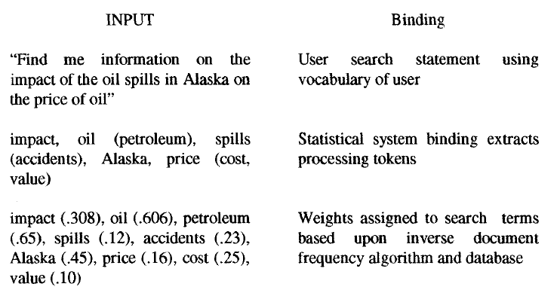
EXAMPLE
Examples of Query Binding

Slide 9
SIMILARITY MEASURES AND RANKING
Searching in general is concerned with calculating the similarity between a user's search statement and the items in the database.
The highest similarity for any of the passages is used as the similarity measure for the item. Restricting the similarity measure to passages gains significant precision with minimal impact on recall.
Once items are identified as possibly relevant to the user's query, it is best to present the most likely relevant items first. This process is called "ranking."

Slide 10
SIMILARITY MEASURES
A variety of different similarity measures calculate the similarity between the Item
can be used to and the search
statement. A characteristic of a similarity formula is that the results of the formula increase as the items become more similar.
If Itemj is replaced with Queryj then the same formula
generates the similarity between every Item and Queryj
The problem with this simple measure is in the normalization needed to account for variances in the length of items. Additional normalization is also used to have the final results come between zero and +1 (some formulas use the range -1 to
+1)..

Slide 11
ROBERTSON AND SPARK JONES APPROACH
Their model suggests that knowledge of terms in relevant items retrieved from a query should adjust the weights of those terms in the weighting process. They used the number of relevant documents versus the number of non- relevant documents in the database and the number of relevant documents having a specific query term versus the number of non-relevant documents having that term to devise four formulas for weighting.

Slide 12
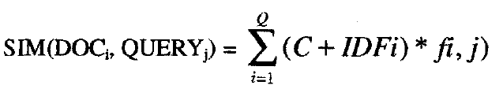
CROFT AND HARPER APPROACH
Croft expanded this original concept of Robertson and Spark Jones approach, taking into account the frequency of occurrence of terms within an item producing the following similarity formula
where C is a constant used in tuning, IDFi is the inverse document frequency for term "i" in the collection and
where K is a tuning constant, TFi,j is the frequency of termi "i" item j and maxfreqj is the maximum frequency of any term in item "j." The best values for K seemed to range between 0.3 and 0.5.

Slide 13
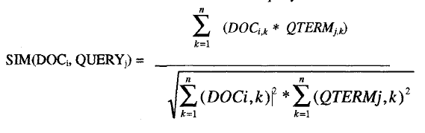
SALTON IN THE SMART SYSTEM
To determine the "weight" an item has with respect to the search statement, the Cosine formula is used to calculate the distance between the vector for the item and the vector for the query:
where DOCi,k is the k m term in tile weighted vector for Item "i" and QTERMj,k is the k th term in query "j."
The Cosine formula calculates the Cosine of the angle between the two vectors. As the Cosine approaches "1," the two vectors become coincident (i.e., the term and the query represent the same concep0. If the two are totally unrelated, then they will be orthogonal and the value of the Cosine is "0."

Slide 14
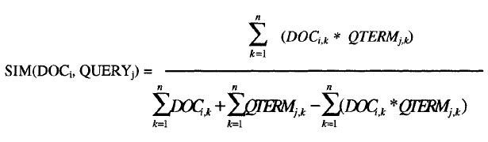
JACCARD AND THE DICE SIMILARITY MEASURES
Both change the normalizing factor in the denominator to account for different characteristics of the data. The denominator in the Cosine formula is invariant to the number of terms in common and produces very small numbers when the vectors are large and the number of common elements is small. In the Jaccard similarity measure, the denominator becomes dependent upon the number of terms in common. As the common elements increase, the similarity value quickly decreases, but is always in the range -1 to +1. The Jaccard formula is :

Slide 15
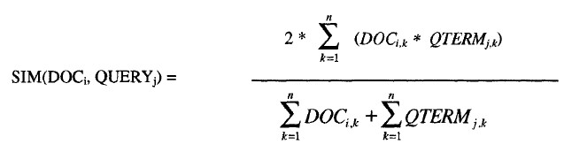
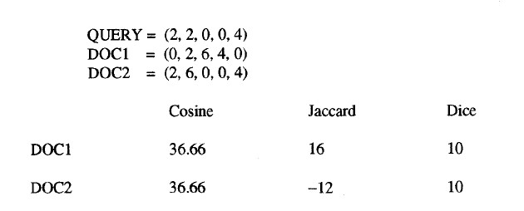
The Dice measure simplifies the denominator from the Jaccard measure and introduces a factor of 2 in tile numerator. The normalization in tile Dice formula is also invariant to the number of terms in common.
Normalizing Factors for Similarity Measures

Slide 16
Use of a similarity algorithm returns tile complete data base as search results. Many of file items have a similarity close or equal to zero (or minimum value the similarity measure produces).
For this reason, thresholds are usually associated with the search process. The threshold defines the items in the resultant Hit file from the query. Thresholds are either a value that the similarity measure must equal or exceed or a number that limits the number of items in the Hit file.
A default is always the case where the similarity is greater than zero.

Slide 17
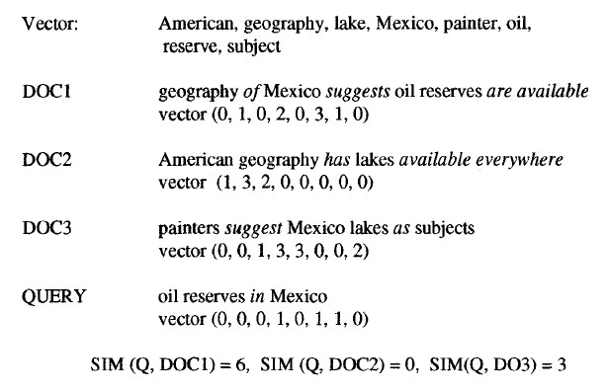
EXAMPLE
Query Threshold Process
The simple "sum of the products" similarity formula is used to calculate similarity between the query and each document. If no threshold is specified, all three documents are considered hits. If a threshold of 4 is selected, then only DOC1 is returned.

Slide 18
HIDDEN MARKOV MODELS TECHNIQUES(HMM)
HMM is used for searching textual corpora has introduced a new paradigm for search.
In HMM the documents are considered to be unknown statistical processes that can generate output that is equivalent to the set of queries that would consider the document relevant. (or)
HMM is defined by output that is produced by passing some unknown key via state transition through a noisy channel.
The Noisy channel is the mismatch between the authors way of expressing ideas and the users ability to specify his query.

Slide 19
LEEK, MILLER AND SCHWARTZ APPROACH
Leek, Miller and Schwartz computed for each document the probability that D was the relevant document in the users mind given that Q was the query produced, i.e P(D is R/Q).
The Development of HMM approach begins with applying Bayes rule to the conditional probability
P(D is R/Q)= P(Q/D is R) * P(D is R)/ P(Q)
HMM is defined by a set of states, a transition matrix defining the probability of moving between states, a set of out put symbols and the probability of the output symbols given a particular state.
Example: State : Words in the Document Transition : Way words combine to make documents.
The Biggest problem in using this approach is to estimate the transition probability matrix and the output for every document in the corpus.

Slide 20
RANKING ALGORITHMS
Ranking the output implies ordering the output from most likely items that satisfy the query to least likely items.
This reduces the user overhead by allowing the user to display the most likely relevant items first. The original Boolean systems returned items ordered by date of entry into the system versus by likelihood of relevance to the user's search statement.
With the inclusion of statistical similarity techniques into commercial systems and the large number of hits that originate from searching diverse corpora, such as the Internet, ranking has become a common feature of modern systems.
Retrieval Ware first uses indexes (inversion lists) to identify potential relevant items.
It applies
Coarse Grain
Fine grain ranking

Slide 21
Coarse Grain
The coarse grain ranking is a weighted formula that can be adjusted based on ..
Completeness
Completeness is the proportion of the number of query terms (or related terms if a query term is expanded using the Retrieval Ware semantic network/thesaurus) found in the item versus the number in the query. It sets an upper limit on the rank value for the item. If weights are assigned to query terms, the weights are factored into the value.

Slide 22
Contextual Evidence or variety and
Contextual evidence occurs when related words from the semantic network are also in the item.
Example: Thus if the user has indicated that the query term "charge" has the context of "paying for an object" then finding words such as "buy," "purchase," "debt“ suggests that the term "charge" in the item has the meaning the user desires and that more weight should be placed in ranking the item.
Semantic Distance
Semantic distance evaluates how close the additional words are to the query term. Synonyms add additional weight; antonyms decrease weight.
The coarse grain process provides an initial rank to the item based upon existence of words within the item. Since physical proximity is not considered in coarse grain ranking, the ranking value can be easily calculated.

Slide 23
Fine grain ranking
Fine grain ranking considers the physical location of query terms and related words using factors of proximity in addition to the other three factors in coarse grain evaluation.
If the related terms and query terms occur in close proximity (same sentence or paragraph) the item is judged more relevant. A factor is calculated that maximizes at adjacency and decreases as the physical separation increases. If the query terms are widely distributed throughout a long item, it is possible for the item to have a fine grain rank of zero even though it contains the query terms.

Slide 24
RELEVANCE FEEDBACK
The relevance feedback concept was that the new query should be based on the old query modified to increase the weight of terms in relevant items and decrease the weight of terms that are in non- relevant items.
This technique not only modified the terms in the original query but also allowed expansion of new terms from the relevant items.
This technique not only modified the terms in the original query but also allowed expansion of new terms from the relevant items.

Slide 25
OVERVIEW
Implement retrieval in multiple passes
Run a query ➔ gather information from the user ➔
enhance the query ➔ repeat the query
The user refines the query in each pass based on results of previous queries
The user indicates which of the documents presented in response of an initial query are relevant
The system may simply assume the top ranked
x documents are relevant
New terms are added to the query based on this selection
Existing terms in the query can be re-weighted based on user feedback
The modified query is re-executed

Slide 26
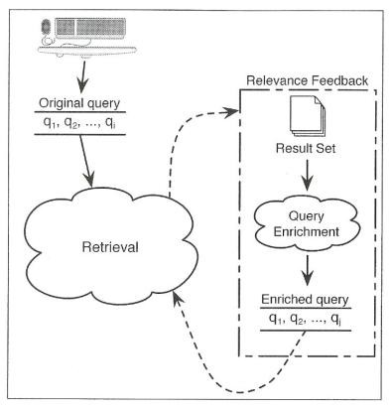
RELEVANCE FEEDBACK PROCESS

Slide 27
EXAMPLE
Initial query: “find information surrounding the various conspiracy theories about the assassination of J. F. Kennedy”
Most useful keywords: assassination, J. F. Kennedy
Noises: various, information
The most t important terms in the top ranked documents will be “good” terms to use in a subsequent query
Oswald
If the top ranked documents contain many occurrences of the term assassination
Increase the weight of “assassination”

Slide 28
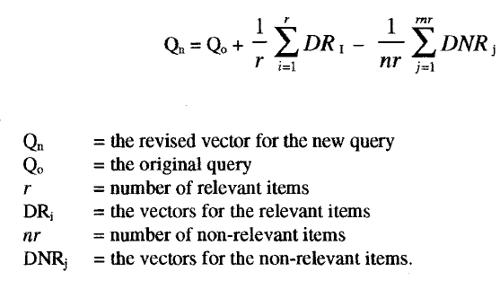
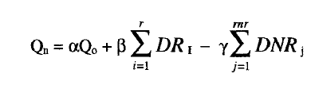
The formula used is:
The factors r and nr were later modified to be constants that account for the number of items along with the importance of that particular factor in the equation. Additionally a constant was added to Qo to allow adjustments to the importance of the weight assigned to the original query. This led to the revised version of the formula:
where α,β and yare the constants associated with each factor (usually 1/n or 1/nr times a constant).

Slide 29


The factor is referred to as positive feedback because it is using the user judgments oll relevant items to increase the values of terms for the next iteration of searching.
The factor is referred to as negative feedback since it decreases the values of terms in the query vector.
Many times only positive feedback is used in a relevance feedback environment. Positive feedback is more likely to move a query closer to a user's information needs.
Negative feedback may help, but in some cases it actually reduces the effectiveness of a query.

Slide 30
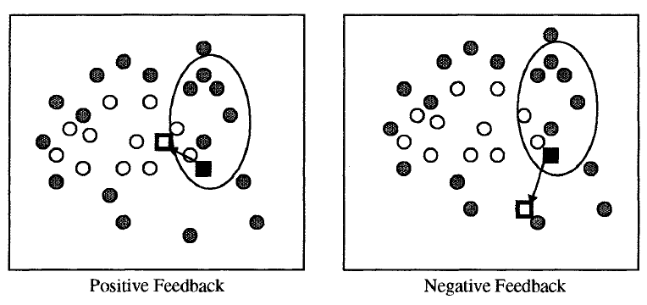
EXAMPLE
The filled circles represent non-relevant items; the other circles represent relevant items.
The oval represents the items that are returned from the query. The solid box is logically where the query is initially. The hollow box is the query modified by relevance feedback (positive only or negative only in the Figure)

Slide 31
Positive feedback moves the query to retrieve items similar to the items retrieved and thus in the direction of more relevant items.
Negative feedback moves the query away from the non-relevant items retrieved, but not necessarily closer to more relevant items.

Slide 32
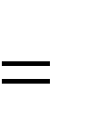
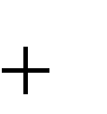



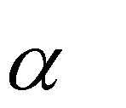


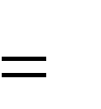
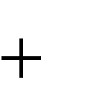



RF IN THE VECTOR SPACE MODEL
Rocchio builds the new query Q’ from the old
query Q by:
Q' Q
1
n₁ n₂
1
R_{i} - _{n} S_{i}
n
1
i 1
2 i 1
The relevant document vectors are added to the initial query vector
The non-relevant document vectors are subtracted
Variations
n₁ n₂
R S
Q' Q
i ₋ n₁
i
i 1
i 1 ^{n}2
min(n₁ , n_{a} ) _{R}
min(n , n )
S
Q' Q
i ₋ n₁
2 b
i
n₂
i 1
i 1

Slide 33
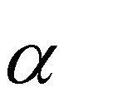
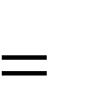

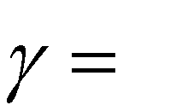
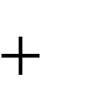
EXAMPLE
 | TERM1 | TERM2 | TERM3 | TERM4 | TERM5
Q | 3 | 0 | 0 | 2 | 0
R₁ | 2 | 4 | 0 | 0 | 2
R₂ | 1 | 3 | 0 | 0 | 0
S₁ | 0 | 0 | 4 | 3 | 3
Q’ | 3 ¾ | 1 ¾ | 0 | 1 ¼ | 0
1,
1 , 1
2 4
¹₂ * ¹₂ *(2
Q' (3,0,0,2,0)
1,4 3,0 0,0 0,2 0) - ¹₄ *1*(0,0,4,3,2)
(3³₄ ,1³₄ ,0{-1},1¹₄ ,0)

Slide 34
EXAMPLE (CONT.) – EFFECT OF
RELEVANCE FEEDBACK
 | R₁ | R₂ | S₁
Q | 6 | 3 | 6
Q’ | 14.5 | 9 | 3.75
SC (Q, R1) = 3 * 2 + 0 * 4 + 0 * 0 + 2 * 0 + 0 * 2 = 6
SC (Q’, R1) = 3 ¾ * 2 + 1 ¾ * 4 + 0 * 0 + 1 ¼ * 0 + 0 * 2 =14.5

Slide 35
DISCUSSION
Although S₁ is not relevant to the user, the initial query Q produced one of the highest similarity measures for it
Caused by a query term (TERM 4) of interest to the user that has a significant weight in S₁
The fewer the number of terms in a user query, the more likely a specific term to cause non-relevant items to be returned
The new query Q’ add a weight to TERM 2 that was not in Q
TERM 2 might not have been in the user’s vocabulary

Slide 36
SELECTIVE DISSEMINATION OF
INFORMATION SEARCH
Selective Dissemination of Information, frequently called dissemination systems, are becoming more prevalent with the growth of the Internet.
A dissemination system is sometimes labeled a "p1ush" system while a search system is called a "pull" system.
The differences are that in a search system the user proactively makes a decision that he needs information and directs the query to the information system to search. In a dissemination system, the user defines a profile (similar to a stored query) and as new information is added to the system it is automatically compared to the user's profile. If it is considered a match, it is asynchronously sent to tile user's "mail" file

Slide 37
The differences between the two functions lie in the dynamic nature of the profiling process, the size and diversity of the search statements and number of simultaneous searches per item.
A dissemination system does not necessarily have a retrospective database associated with it. Thus its algorithms need to avoid dependency upon previous data or develop a technique to estimate terms for their formula.
Profiles are relatively static search statements that cover a diversity of topics.
The size tends to make them more complex and discourages users from wanting to change them without expert advice.

Slide 38
LOGICON MESSAGE DISSEMINATION SYSTEM (LMDS)
One of the first commercial search techniques for dissemination.
It was designed for speed to support the search of thousands of profiles with items arriving every 20 seconds. It demonstrated one approach to the problem where the profiles were treated as the static database and the new item acted like the query. It uses the terms in the item to search tile profile structure to identify those profiles whose logic could be satisfied by the item. The system uses a least frequently occurring tri graph (three character) algorithm that quickly identifies which profiles are not satisfied by the item. The potential profiles are analyzed in detail to confirm if the item is a hit.

Slide 39
PERSONAL LIBRARY SOFTWARE (PLS)
SYSTEM
It uses the approach of accumulating newly received items into the database and periodically running user's profiles against the database.
This makes maximum use of the retrospective search software but loses near real time delivery of items.

Slide 40
SCHUTZE
Another approach to dissemination uses a statistical classification technique and explicit error minimization to determine the decision criteria for selecting items for a particular profile.
In this case, the classification process is related to assignment for each item into one of two classes: relevant to a user's profile or non-relevant.
Error minimization encounters problems in high dimension spaces. The dimensionality of an information space is defined by the number of unique terms where each term is another dimension. This is caused by there being too many dimensions for a realistic training set to establish the error minimization parameters. To reduce the dimensionality, a version of latent semantic indexing (LSI) can be used.

Slide 41
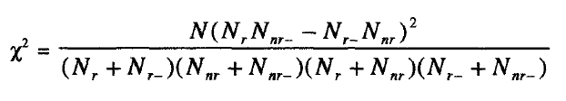
Schutze et al. used two approaches to reduce the dimensionality:
selecting a set of existing features to use or
creating a new much smaller set of features that the original features are mapped into.
A X² measure was used to determine the most important features. The test was applied to a table that contained the number of relevant (Nr) and non-relevant (Nnr) items in which a term occurs plus the number of relevant and non- relevant items in which the term does not occur (Nr_, Nnr_ respectively). The formula used was:

Slide 42
LATENT SEMANTIC INDEX (LSI)
An alternative technique to identify the reduced feature (vector) set is to use a modified latent semantic index (LSI) technique to determine a new reduced set of concept vectors.
The results of the analysis go into a learning algorithm associated with the classification technique (Hull-94). The use of the profile to define a local region is essential when working with large databases.
Otherwise the number of LSI factors is in the hundreds and the ability to process them is currently unrealistic.

Slide 43
WEIGHTED SEARCHES OF BOOLEAN SYSTEMS
The two major approaches to generating queries are
Boolean and
Natural Language.
Natural language queries are easily represented within statistical models and are usable by the similarity measure.
To integrate the Boolean and weighted systems model, Fox and Sharat proposed a fuzzy set approach. Fuzzy sets introduce the concept of degree of membership to a set. The degree of membership for AND and OR operations are defined as:
DEGA∩B =
DEGAUB =
min(DEGA, DEGB) max(DEGA, DEGB)
where A and B are terms in an item. DEG is the degree of membership.

Slide 44
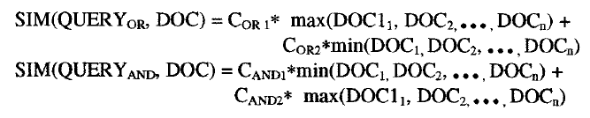
The Mixed Min and Max (MMM) model considers the similarity between query and document to be a linear combination of the minimum and maximum item weights.
Fox proposed the following similarity formula:
where COR1 and COR2 are weighting coefficients for the OR operation and CAND1 and CAND2 are the weighting coefficients for the AND operation.
Lee and Fox found in their experiments that the best performance comes when CAND1 is between 0.5 to 0.8 and Coal is greater than 0.2.

Slide 45

PAICE APPROACH
The MMM technique was expanded by Paice (Paice- 84) considering all item weights versus the maximum/minimum approach. The similarity measure is calculated as:
where the di's are inspected in ascending order for AND queries and descending order for OR queries. The r terms are weighting coefficients. Lee and Fox showed that the best values for r are 1.0 for AND queries and 0.7 for OR queries (Lee-88).
This technique requires more computation since the values need to be stored in ascending or descending order and thus must be sorted.

Slide 46
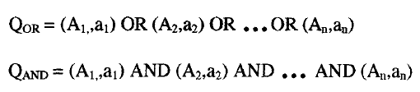
An alternative approach is using the P-norm model which allows terms within the query to have weights in addition to the terms in the items.
Similar to the Cosine similarity technique, it considers the membership values (dA1 . . . . . dAn) to be coordinates in an "n" dimensional space. For an OR query, the origin (all values equal zero) is the worst possibility. For an AND query the ideal point is the unit vector where all the Di values equal 1. Thus the best ranked documents will have maximum distance from the origin in an OR query and minimal distance from the unit vector point.
The generalized queries are:

Slide 47
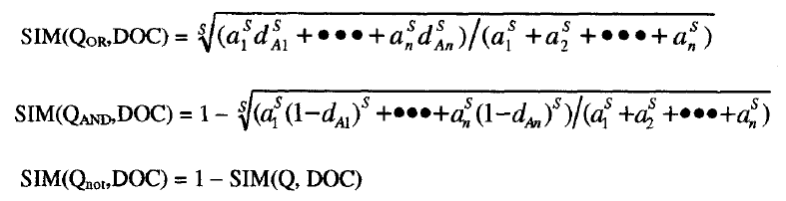
The operators (AND and OR) will have a strictness value assigned that varies from 1 to infinity where infinity is the strict definition of the Boolean operator. The ai values are the query term weights. If we assign the strictness value to a parameter labeled "S" then the similarity formulas between queries and items are:

Slide 48
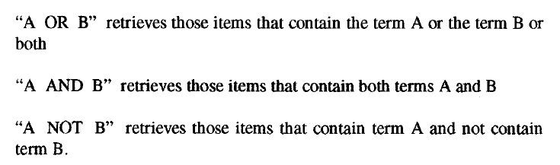
Another approach suggested by Salton provides additional insight into the issues of merging the Boolean queries and weighted query terms under the assumption that there are no weights available in the indexes.
The following procedure is a modification to his approach for defining search results. The normal Boolean operations produce the following results:

Slide 49
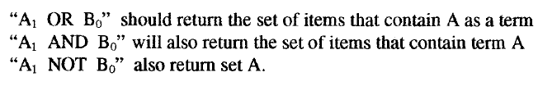
If weights are then assigned to the terms between the values 0.0 to 1.0, they may be interpreted as the significance that users are placing on each term.
This suggests that as the weight for term B goes from 0.0 to 1.0 the resultant set changes from the set of all items that contains term A to the set normally generated from the Boolean operation.

Slide 50
THE ALGORITHM FOLLOWS THE
FOLLOWING STEPS:
Determine the items that are satisfied by applying strict interpretation of the Boolean functions
Determine the items that are part of the set that is invariant.
Determine the Centroid of the invariant set
Determine the number of items to be added or deleted by multiplying the term weight times the number of items outside of the invariant set and rounding up to the nearest whole number
Determine the similarity between items outside of the invariant set and the Centroid
Select the items to be included or removed from the final set

Slide 51
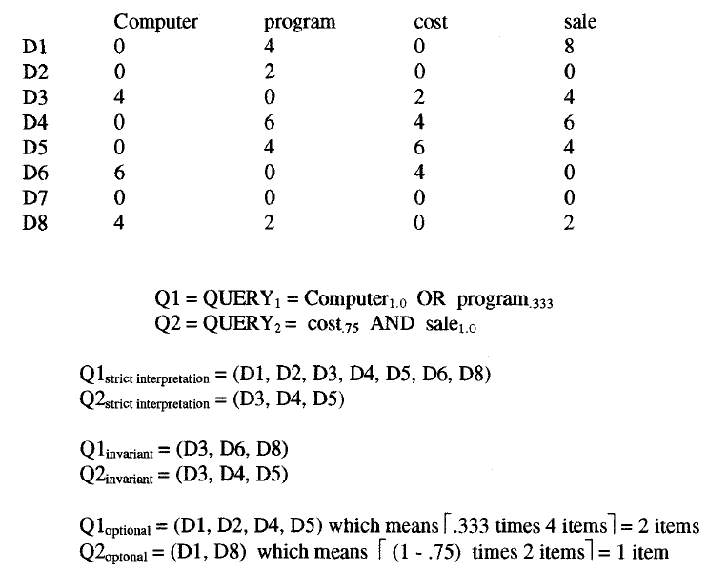
EXAMPLE OF WEIGHTED BOOLEAN QUERY

Slide 52
contains all of set "cost" AND "sale" plus .25 of the set of "sale" NOT "cost."
Using the simple similarity measure: SIM(Itemi, Itemj) = ∑(Termi,k) (Termj,k)
leads to the following set of similarity values based upon the centroids:
CENTROID (Q1) = (D3, D6, D8) = 1/3(4+6+4, 0+0+2, 2+4+0, 4+0+2) CENTROID (Q2) = (D3, D4, D5) = 1/3(4+0+0, 0+6+4, 2+4+6, 4+6+4) SIM(CENTROIDQ1,D1) = 1/3(0 + 8 + 0 + 48) = 1/3(56) SIM(CENTROIDQ1,D2) = 1/3(0 + 4 + 0 + 0) = 1/3(4)
SIM(CENTROIDQ1,D4) = 1/3(0 + 12 + 24 + 36) = 1/3(72) SIM(CENTROIDQ1,D5) = 1/3(0 + 8 + 36 + 24) = 1/3(68) SIM(CENTROIDQ2,D1) = 1/3(0 + 40 + 0 + 112) =1/3(152) SIM(CENTROIDQ2,D8) = 1/3(16 + 20 +0 +28) = 1/3(64)
For Q1, two additional items are added to the invariant set
(D3, D6,D8) U (D4, D5) giving the answer of (D3, D4, D5, D6, D8).
For Q2, one additional item is added to the invariant set (D3, D4, D5) U(D1) giving the answer (D1, D3, D4, D5).

Slide 53
SEARCHING THE INTERNET AND
HYPERTEXT
The Internet has multiple different mechanisms that are the basis for search of items. The primary techniques are associated with servers on the Internet that create indexes of items on the Internet and allow search of them.
Closely associated with the creation of the indexes is the technique for accessing nodes on the Internet to locate text to be indexed. This search process is also directly available to users via Intelligent Agents. Intelligent Agents provide the capability for a user to specify an information need which will be used by the
Intelligent Agent as it independently moves between Internet sites locating information of interest.

Slide 54
THERE ARE SIX KEY CHARACTERISTICS OF INTELLIGENT AGENTS
Autonomy - the search agent must be able to operate without interaction with a human agent. It must have control over its own internal states and make independent decisions. This implies a search capability to traverse information sites based upon pre-established criteria collecting potentially relevant information.
Communications Ability - the agent must be able to communicate with the information sites as it traverses them. This implies a universally accepted language defining the external interfaces

Slide 55
3. Capacity for Cooperation - this concept suggests that intelligent agents need to cooperate to perform mutually beneficial tasks.
Capacity for Reasoning - There are three types of reasoning scenarios
Rule-based - where user has defined a set of conditions and actions to be taken
Knowledge-based - where the intelligent agents have stored previous conditions and actions taken which are used to deduce future actions
Artificial evolution based - where intelligent agents spawn new agents with higher logic capability to perform its objectives.

Slide 56
Adaptive Behavior - closely tied to 1 and 4, adaptive behavior permits the intelligent agent to assess its current state and make decisions oil the actions it should take
Trustworthiness - the user must trust that the intelligent agent will act on the user's behalf to locate information that the user has access to and is relevant to the user.
There are many implementation aspects of Intelligent Agents. They include communications to traverse the Internet, how to wrap the agent in an appropriate interface shell to work within an Internet server, and security and protection for both the agent and the servers.

Slide 57
Automatic relevance feedback is being used in a two- step process to enhance user's queries to include corpora-specific terminology.
As an intelligent agent moves from site to site, it is necessary for it to use similar techniques to learn the language of the authors and correlate it to the search need of the user.
How much information gained from relevance feedback from one site should be carried to the next site has yet to be resolved. Some basic groundwork is being laid by the work on incremental relevance feedback discussed earlier.
Finally, there is the process of searching for information on the Internetby following Hyperlinks . A Hyperlink is an embedded link to another item that can be instantiated by clicking on the item reference. Frequently hidden to the user is a URL associated with the text being displayed.

Slide 58
Information Visualization

Slide 59
TOPICS
Introduction to Information Visualization
Cognitive and Perception
Information Visualization Technologies

Slide 60
FUNCTIONS THAT ARE AVAILABLE WITH
ELECTRONIC DISPLAY AND VISUALIZATION OF DATA THAT WERE NOT PREVIOUSLY PROVIDED ARE
Modify representations of data and information or the display condition (e.g., changing color scales)
Use the same representation while showing changes in data (e.g., moving between clusters of items showing new linkages)
Animate the display to show changes in space and time
Enable interactive input from the user to allow dynamic movement between information spaces and allow the user to modify data presentation to optimize personal preferences for understanding the data.
Create hyperlinks under user control to establish relationships between Data

Slide 61
Information Visualization addresses how the results of a search may be optimally displayed to the users to facilitate their understanding of what the search has provided and their selection of most likely items of interest to read.
Visual displays can consolidate the search results into a form easily processed by the user's cognitive abilities, but in general they do not answer the specific retrieval needs of the user other than suggesting database coverage of the concept and related concepts.
The theoretical disciplines of cognitive engineering and perception provide a theoretical base for information visualization. Cognitive engineering derives design principles for visualization techniques from what we know about the neural processes involved with attention, memory, imagery and information processing of the human visual system.
Visualization can be divided into two broad classes: link visualization and attribute (concept) visualization.
Link visualization displays relationships among items.
Attribute visualization reveals content relationships across large numbers of items.

Slide 62
INTRODUCTION TO INFORMATION VISUALIZATION
Information visualization is a relatively new discipline growing out of the debates in the 1970s on the way the brain processes and uses mental images.
It required significant advancements in technology and information retrieval techniques to become a possibility.
In the 1990s technical advancements along with exponential growth of available information moved
the discipline into
practical research and Information
commercialization.
visualization
techniques have the potential to significantly enhance the user's ability to minimize resources expended to locate needed information.

Slide 63
Understanding associated with
the human cognitive process
visual data suggests alternative
ways of presenting and manipulating information to focus on the likely relevant items. There are many areas that information visualization and presentation can help the user:
Reduce the amount of time to understand the results of a search and likely clusters of relevant information
Yield information that comes from the relationships between items versus treating each item as independent
Perform simple actions that produce sophisticated information search functions

Slide 64
The exponential growth in available information produces large Hit files from most searches. To understand issues with the search statement and retrieved items, the user has to review a significant number of status screens.
The query logically extracts a virtual workspace (information space) of potential relevant items which can be viewed and manipulated by the user. By representing the aggregate semantics of the workspace, relationships between items become visible.

Slide 65
COGNITION AND PERCEPTION

